Slide 1
Dominion KX III Release 3.5 (Build 2115)
Secondary Headline

Slide 2
Dominion KX III - Release 3.5.0.5.2115
October 2018 Update
HKC runs on Apple iOS Devices (iPad & iPhone) from KX3 and CC-SG
Support HKC for KX III Dual Port Groups from CC-SG
Option to Hide KVM Client Toolbar and Menu Bar
Video Resolution Fix
Security Updates

Slide 3
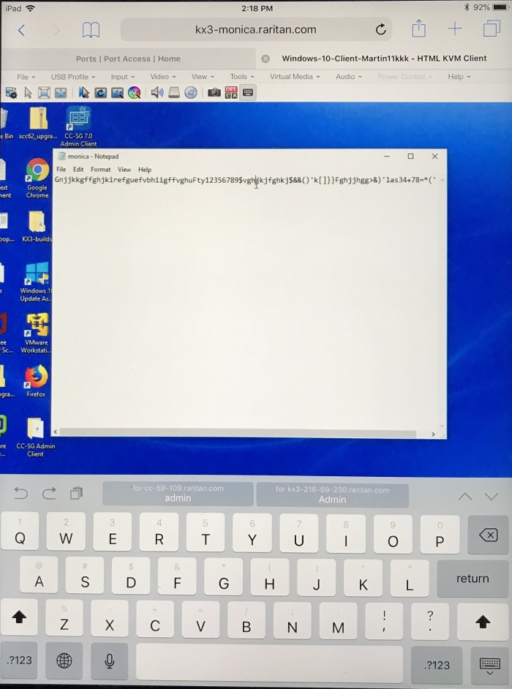
HTML KVM Client for Apple iOS Devices (iPad & iPhone)
Works Standalone and with CommandCenter (CC-SG)
Works from KX3 and CC-SG HTML User Interfaces
Launch via Safari Browser on iPhone or iPad
Convenient, no App to Download!
Secure connections via Installed Certificate on iOS device
Must load a digital certificate on the iOS device
Video, Keyboard & Touchscreen Mouse
Uses Apple iOS keyboard
Can click, drag windows and pinch to scroll
Supports Macros
Standard KVM Client features for keyboard, video and mouse
Support for Virtual Media (ISO image) and Digital Audio

Slide 4
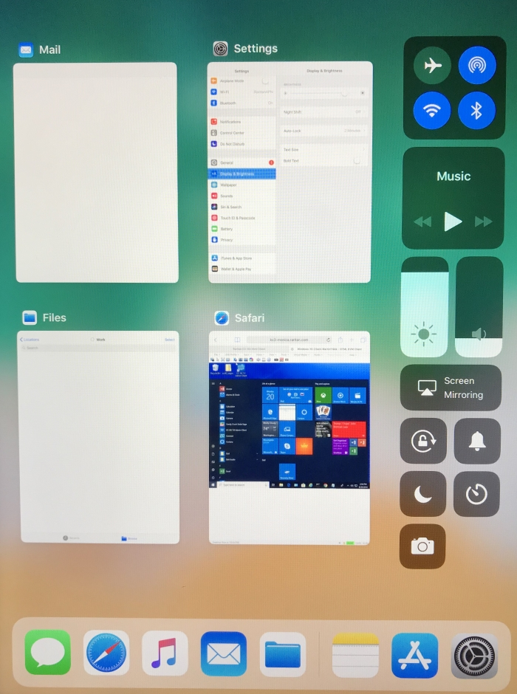
HKC on iPAD Desktop

Slide 5
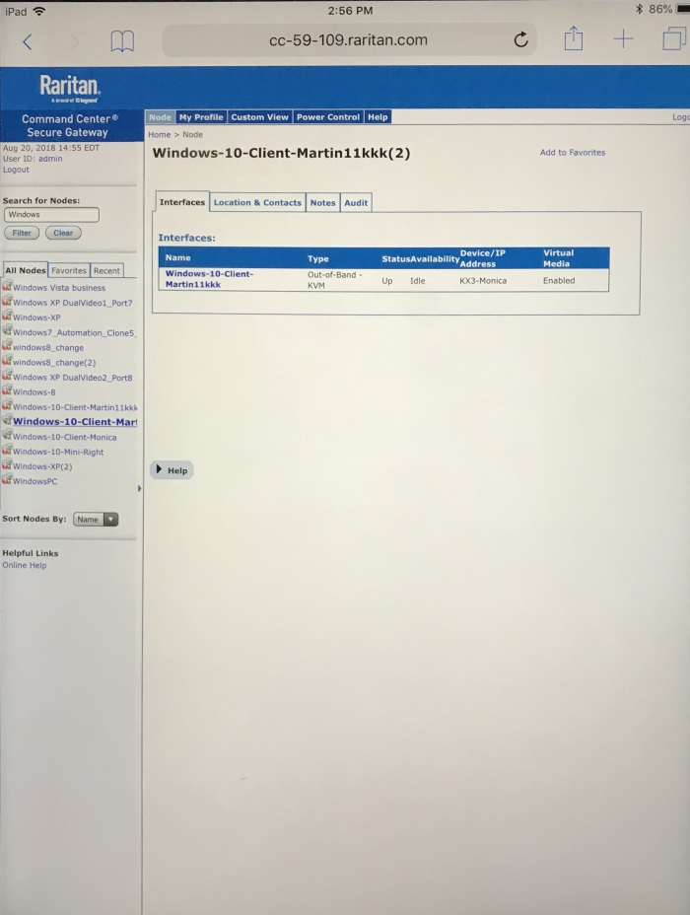
Launch HKC from CC-SG

Slide 6
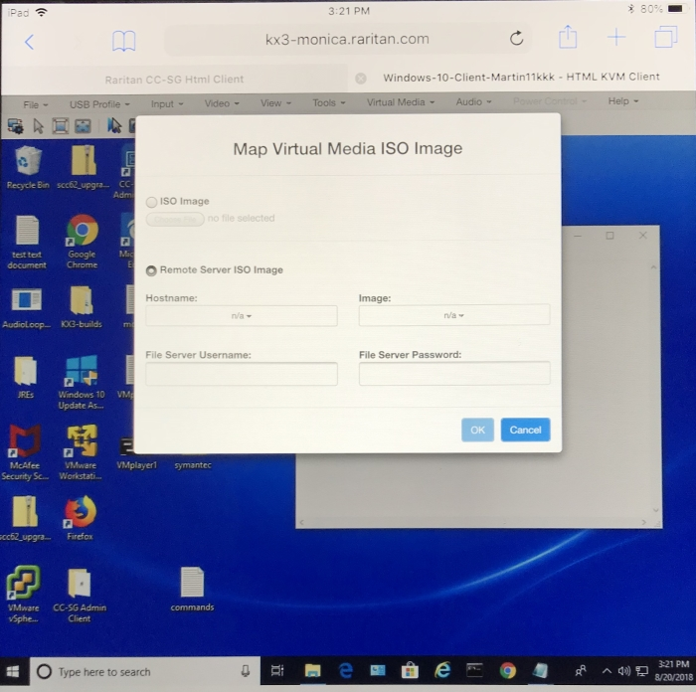
HKC Virtual Media ISO Image

Slide 7
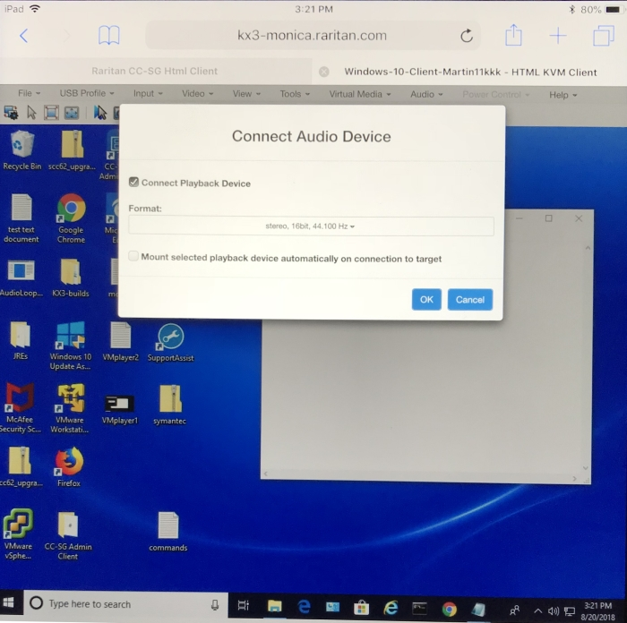
HKC Digital Audio

Slide 8
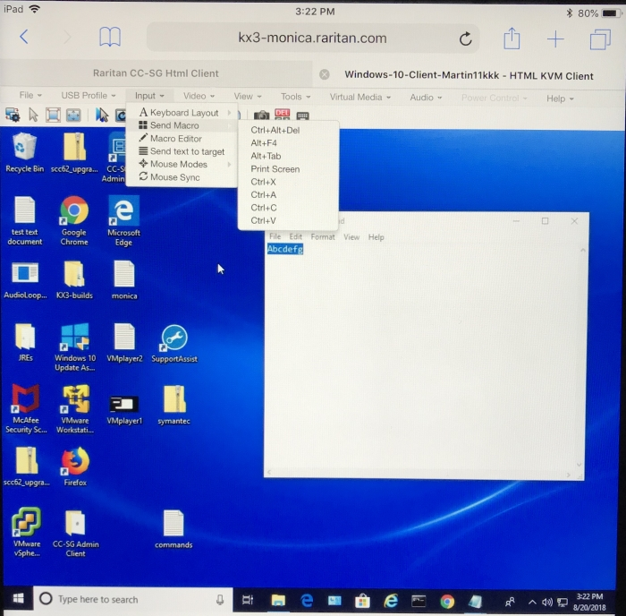
HKC on iOS – Keyboard Macros

Slide 9
HKC with iPAD Keyboard

Slide 10
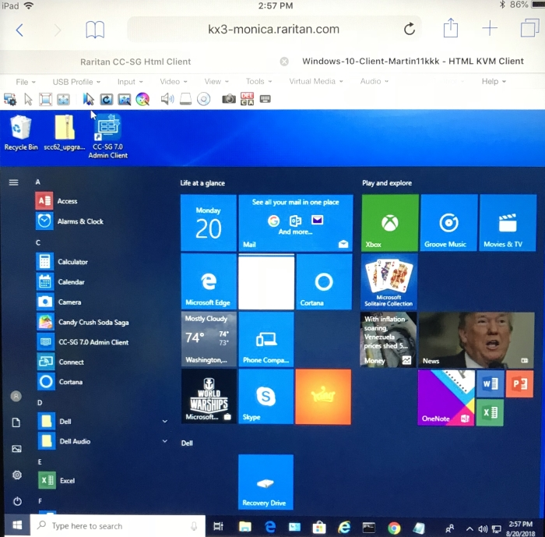
HKC Windows 10

